Slide 1
Provincial Assessment Results: ELPA 2019-2020
Assessment, Analysis & Design Services Branch (Anglophone Division)
Department of Education and Early Childhood Development
Notes:
Slides 1-14 only

Slide 2
Provincial Assessment in 2019-20
COVID-19 resulted in cancellation of all but:
English Language Proficiency Assessment (ELPA)
Grade 12 French Oral Proficiency Interviews
Grade 10 French Oral Proficiency Interviews (partial)

Slide 3
ELPA Background
Assessment based on end of Grade 8 reading proficiency standards
Administered to 4,957 Grade 9 students in January 2020
Unsuccessful Grade 9 students receive support in Grade 10 and can re-write in Grade 11 and 12
Is normally a graduation requirement unless an exemption is granted
Writing, speaking and listening are assessed at the classroom level
Notes:
Waived graduation requirement for 2019-20 to avoid disadvantaging students who did not pass and would normally have had another chance to be assessed in August.

Slide 4
Transition to IRT Analysis
Began moving from Classical Analysis (CA) to Item Response Theory (IRT) in 2017-18
ELPA was the last one to transition
EECD commitment to a shared approach to analysis between the two linguistic sectors

Slide 5
Benefits of IRT Analysis
Factors the difficulty level of each assessment item into the calculation of results
Fairer for students (greater precision for calculating scores and ability levels)
Permits more precise equating of results from year to year (results are attributable to ability level of the cohort, not changes in the assessment)
Provides assessment item developers with information from seven specific statistical parameters to improve precision of assessment items
Notes:
Two students with the same percentage of correct responses may have different results depending on the difficulty of the items they answered correctly.

Slide 6
Advantages for transitioning to IRT this year:
Establishment of a new baseline means loss of comparability with historical data,
but
increased fairness for students due to the precision of IRT is a compelling reason to switch.
The decision to waive the graduation requirement for the 2019-20 ELPA means that the transition to IRT analysis did not impact this year’s graduates.
Notes:
Cut Point Setting: Following the protocol used for establishing the reference year, results have been verified and validated through a quantitative standard-setting session.

Slide 7
Results
21.9% not successful,
66.5% Appropriate Achievement
11.6% Strong Achievement
Note: Results do not include exempted students

Slide 8
Notes:
Because of the change of methodology, the results of this year’s ELPA cannot be directly compared with those of previous years, however, it is confirmed that performance of the 2018-19 and 2019-20 cohorts was weaker than that of the 2017-18 cohort.

Slide 9
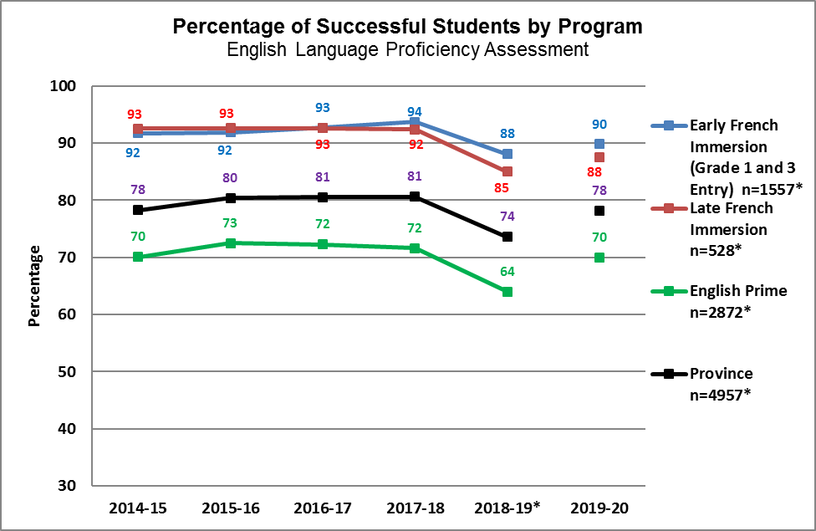

Slide 12
Exemption Rates by District
2019-20 ELPA Exemptions
District | Number of Grade 9 Students | Number of Students Exempted | Percent Exempt
ASD North | 578 | 27 | 4.7%
ASD East | 1170 | 35 | 3.0%
ASD South | 1686 | 61 | 3.6%
ASD West | 1719 | 73 | 4.2%
Province | 5153 | 196 | 3.8%

Slide 13
Exemption Rates by Year
Year | Number of Grade 9 Students | Number of Students Exempted | Percent Exempt
2015-16 | 5063 | 167 | 3.2%
2016-17 | 4939 | 208 | 4.2%
2017-18 | 4924 | 215 | 4.4%
2018-19 | 5168 | 217 | 4.2%
2019-20 | 5153 | 196 | 3.8%
Province | 5168 | 217 | 4.2%

